Slide 1
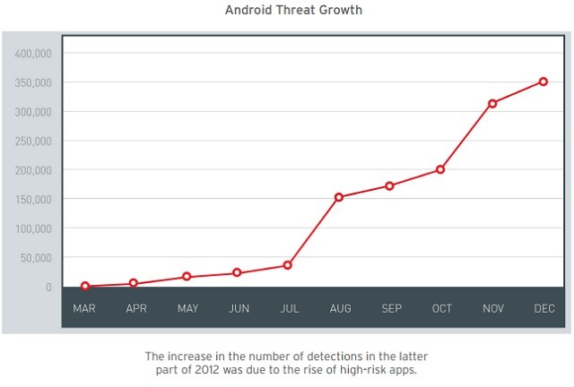
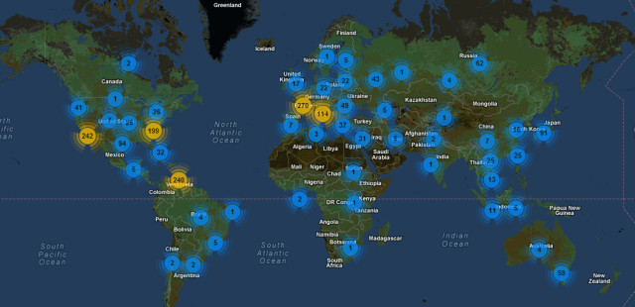
Immersion in the Discipline Braden Licastro
US world leader in botnets
631 currently active
Virgin Islands next largest with 237
3 years to match number of threats on windows devices
Apple devices following vulnerability trend

